Slide 1
CODA FILE SYSTEM

Slide 2
CODA
Coda has been developed at Carnegie Mellon University (CMU) in the 1990s, and is now integrated with a number of popular UNIX-based operating systems such as Linux.
Coda was designed to be a scalable, secure, and highly available distributed file system.
An important goal was to achieve a high degree of naming and location transparency so that the system would appear to its users very similar to a pure local file system.
Coda is a descendant of version 2 of the Andrew File System (AFS)

Slide 3
Organization
Coda follows the same organization as AFS.
Every Virtue workstation hosts a user-level process called Venus, whose role is similar to that of an NFS client.
A Venus process is responsible for providing access to the files that are maintained by the Vice file servers.
In Coda, Venus is also responsible for allowing the client to continue operation even if access to the file servers is (temporarily) impossible.
The important issue is that Venus runs as a user-level process.
There is a separate Virtual File System (VFS) layer that intercepts all calls from client applications, and forwards these calls either to the local file system or to Venus,

Slide 4
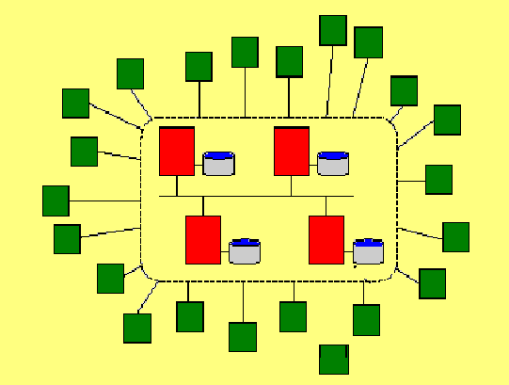
AFS Architecture
The Coda architecture is based on AFS: The Andrew File System
Transparent access
to a Vice file server
AFS is divided into two types
of nodes:
1. Vice nodes: dedicated file servers
2. Virtue nodes: client machines
Virtue Client
Vice file server

Slide 5
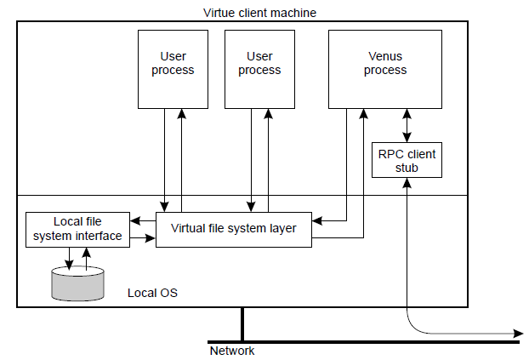
The internal organization of a Virtue workstation

Slide 6
Communication
Interprocess communication in Coda is performed using RPC2.
RPC2 offers reliable RPCs on top of the (unreliable) UDP protocol. Each time a remote procedure is called, the RPC2 client code starts a new thread that sends
an invocation request to the server and subsequently blocks until it receives an answer
An interesting aspect of RPC2 is its support for side effects.
A side effect is a mechanism by which the client and server can communicate using an application-specific protocol.

Slide 7
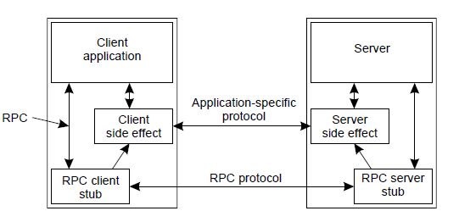
Side Effect

Slide 8
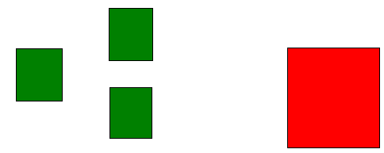
F
File
Invalidate F
F
F
F
Invalidate F
F
Updated File
F
F
Invalidate F
File server
client
When a server notices updates in a file, it must inform the client which
are caching a copy of it to invalidate that copy.

Slide 9
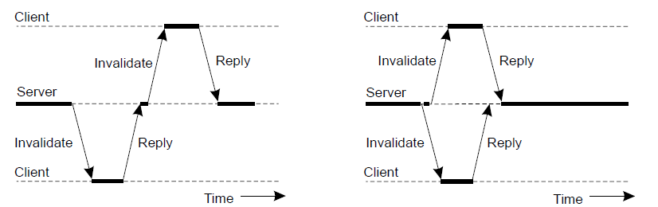
Multicasting
(a) (b)
RPC2 support multicasting.
When a file is modified, a server invalidates local copies by notifying the appropriate clients through an RPC.
fig shows sending
(a) an invalidation message one at a time.
(b) Sending invalidation messages in parallel

Slide 10
Spread Spectrum
Spread the narrow band signal into a broad band signal using a special code.
Protection against narrow band interference

Slide 11
